Slide 1
Approvals
For PeopleSoft Finance

Slide 2
Transactions Requiring Approval
Journal Entries
Budget Transfers (Budget Amendments)
eTravel Requests (new system being developed)

Slide 3
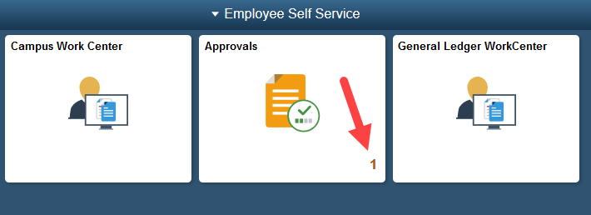
Approvals Tile
Journal Entries
Budget Transfers

Slide 4
Pending Approvals
Transaction type
ID number
Submission date
Name of originator
Dollar amount

Slide 5
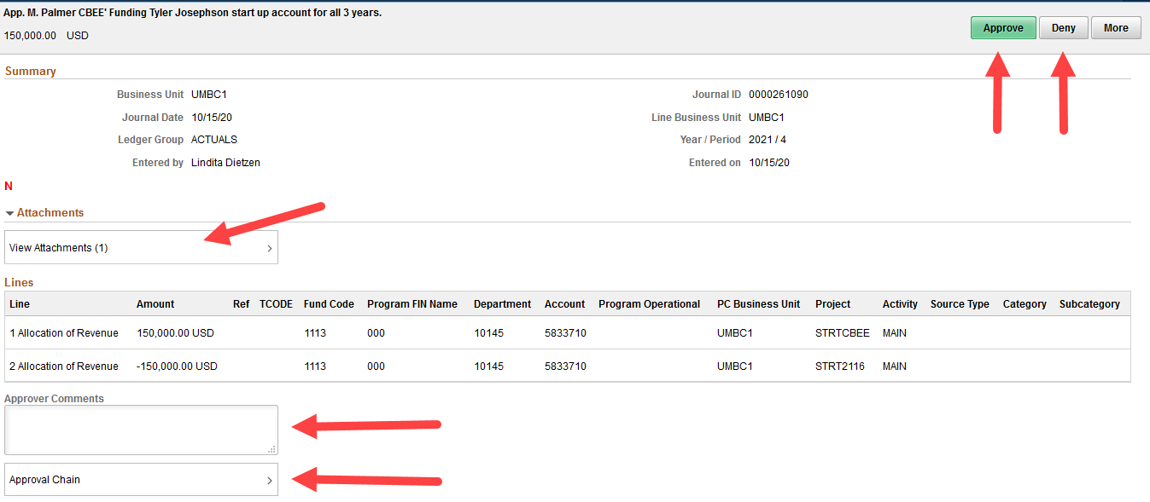
Transaction Details

Slide 6
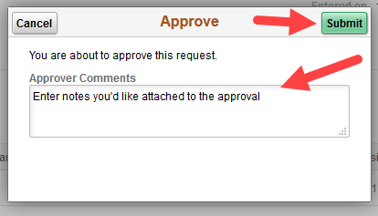
Approve or Deny

Slide 7
Accessing the Worklist
eTravel Approvals

Slide 8
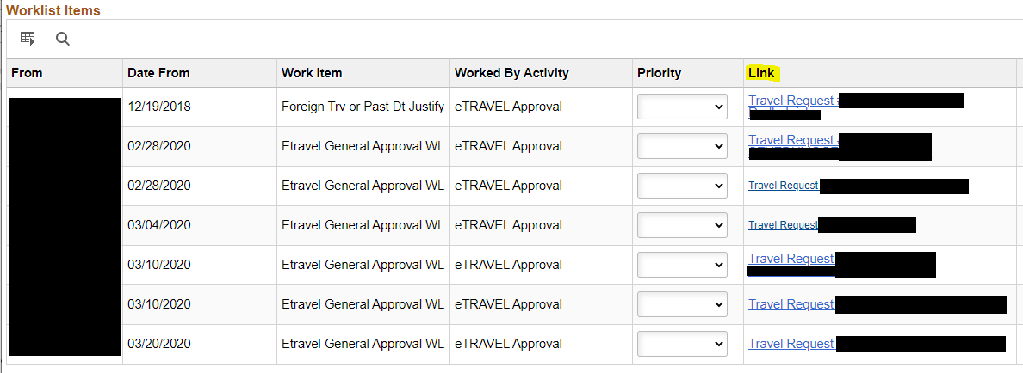
Worklist

Slide 9
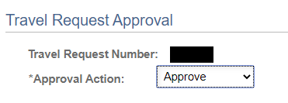
eTravel Approval

