Slide 1
Navigation
For PeopleSoft Finance

Slide 2
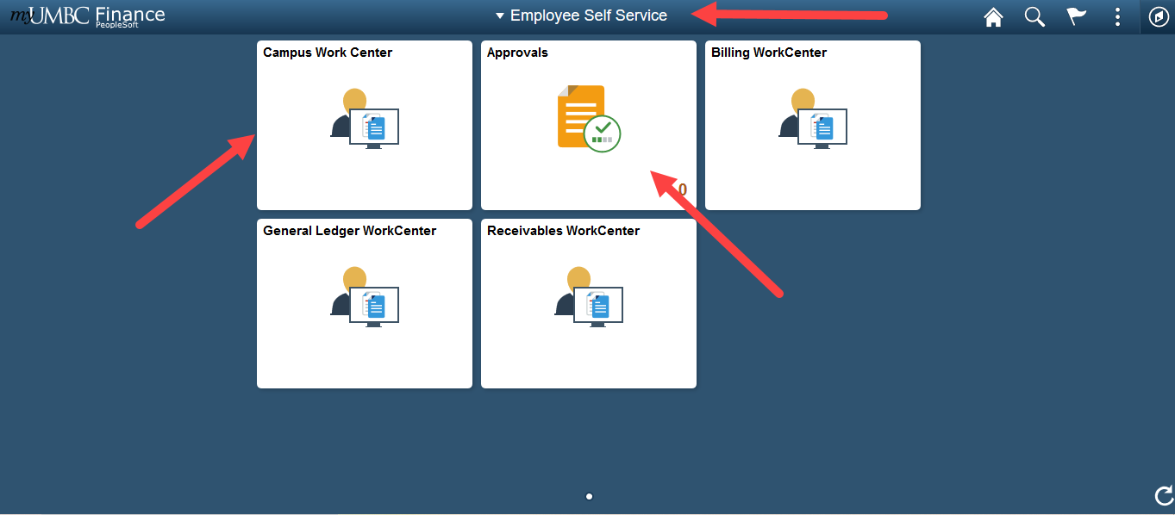
Employee Self Service
Campus Work Center
Approvals
Other Work Centers

Slide 3
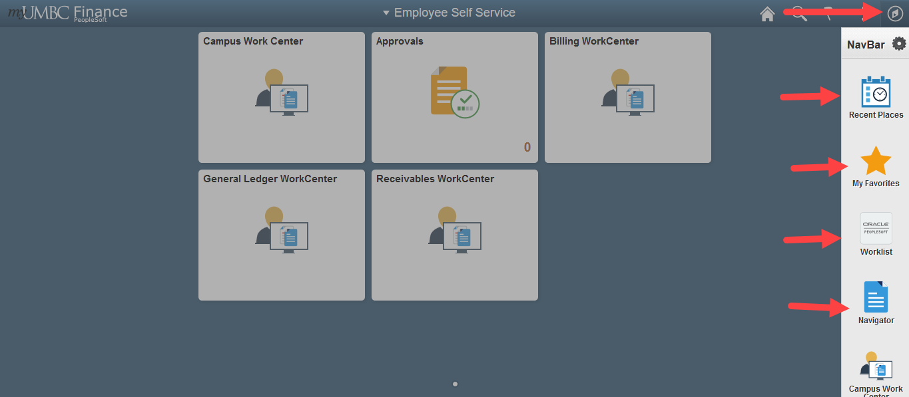
NAVBAR

Slide 4
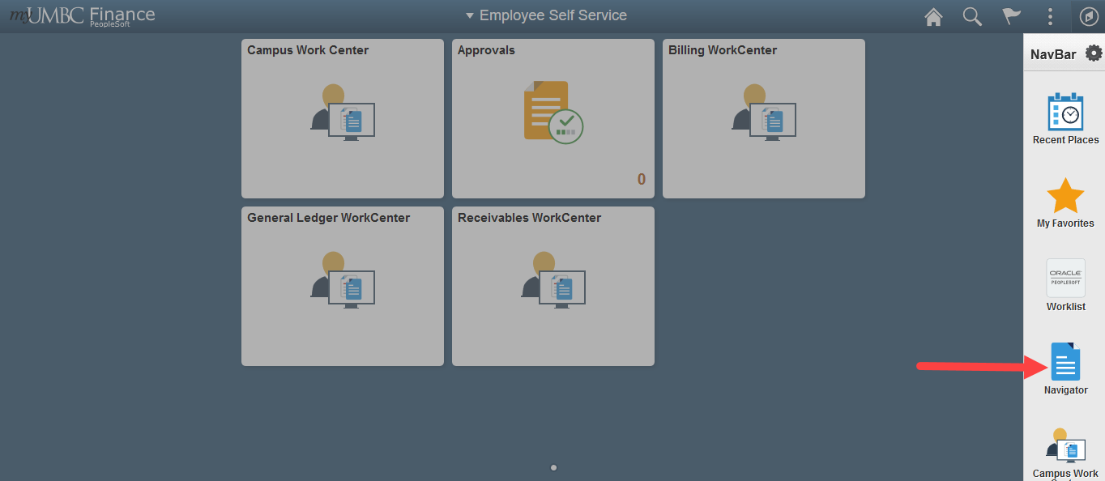
Navigator

Slide 5
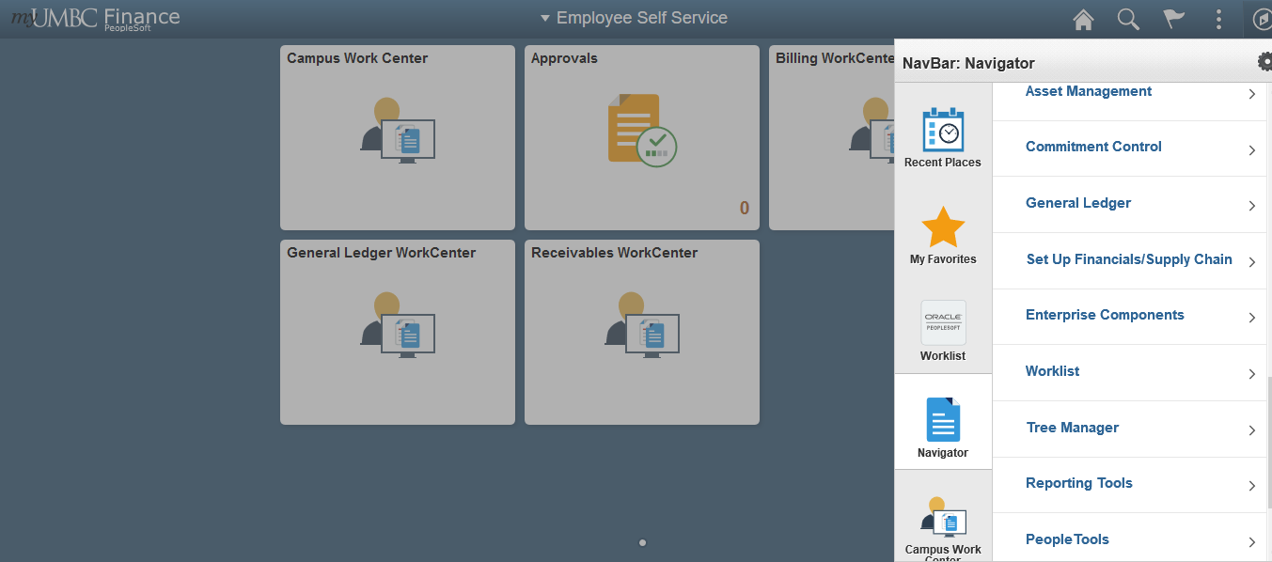
Navigator (cont.)

Slide 6
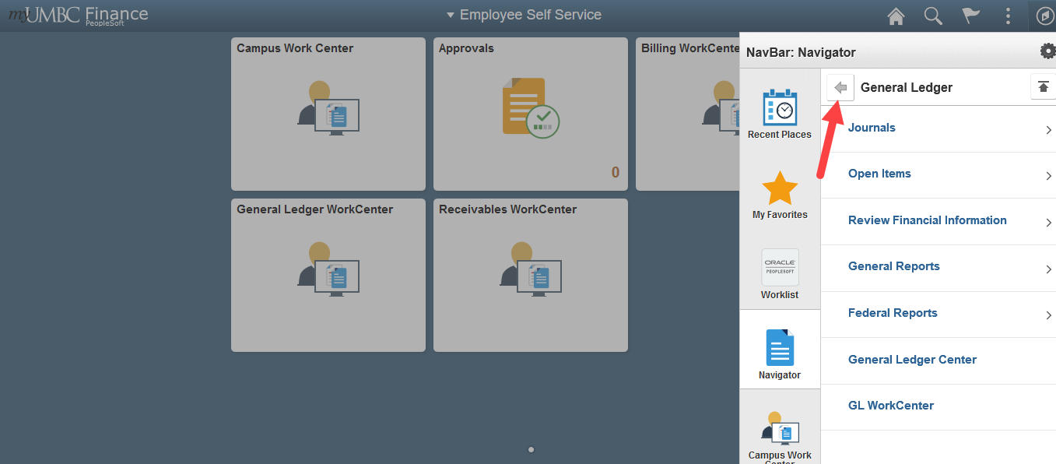
Navigator – Back bar

Slide 7
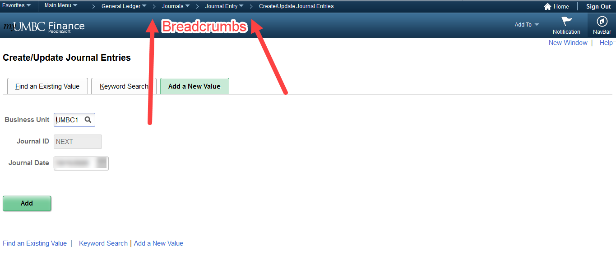
Breadcrumbs

Slide 8
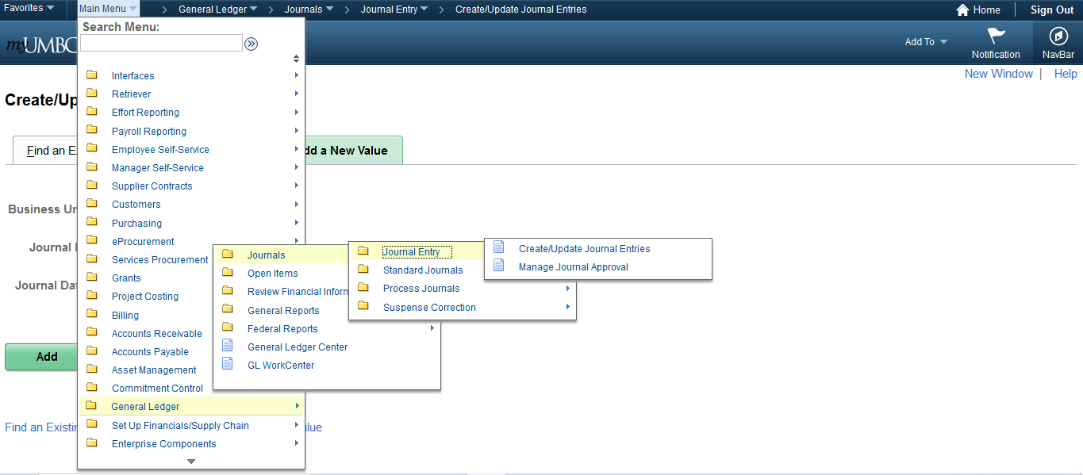
Breadcrumbs (cont.)

